Slide 1
From Hex to Exe

Slide 2
Why create an exe:
  Educative value: know what is inside
  Mandatory if you want to create your own language that is not interpredted
Create a simple exe
Inspect it with an hex editor
Exe structure
Understanding the headers
Create a very simple exe
Add call to system functions

Slide 3
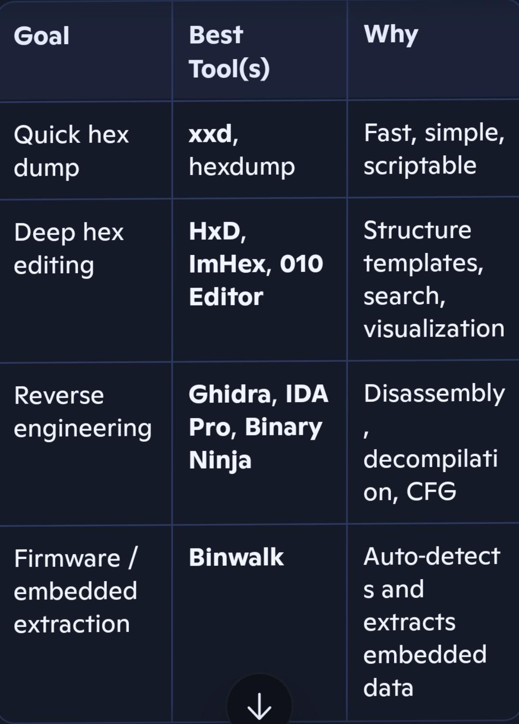
tools
there is also objdump
I use xdd and ImHex

Slide 4
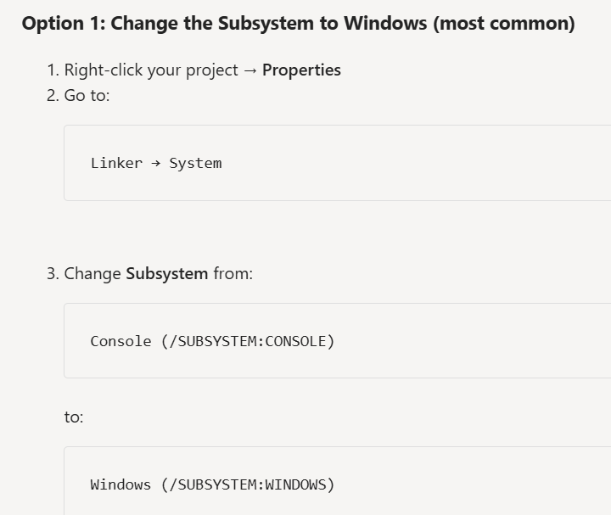
Dialogbox
To avoid the terminal :

Slide 5
EXE File Structure
DOS Header
Historic part used for DOS compatibility !
DOS Stub
COFF header
Mostly historic stuff
Optional header
Declaration of the stack, the heap, the import tables,…
Section table
Declaration of the sections
Section 1
Section 2
Code, static data, import tables content
Section n

Slide 6
Loading an EXE in Memory

Slide 7
Excellentes Videos
https://www.youtube.com/watch?v=5_UCkcb7iGY smallest EXE explique comment faire un jeu en console en limitant les appels à Kernel32
https://www.youtube.com/watch?v=OkX2lIf9YEM PE format: explique les headers en detail
Useful tool : “\Program Files\Microsoft Visual Studio\18\Community\VC\Tools\MSVC\14.51.36231\bin\Hostx64\x64”\dumpbin /imports \myfiles\myPresentations\Creer_un_exe\Code\dlgbox\x64\Release\dlgbox.exe

Slide 8
Sections (we don’t call them segments anymore: Segments is for 16bits)
section | Purpose
.text | Executable machine code (functions and instructions) | Code: Read Execute
.data | Initialized global and static variables | Initialized data: Read, Write
.rdata | Read-only data, string literals, constants, RTTI, vtables | Initialized data: Read
.bss | Uninitialized global/static variables (often represented via virtual size rather than raw file data) | Uninitialized data: Read, Write
.idata | Import table (functions imported from DLLs) | Initialized data: Read, Write
.edata | Export table (mainly for DLLs) | Initialized data: Read
.rsrc | Resources such as icons, bitmaps, dialogs, version info | Initialized data: Read
.reloc | Relocation information used if the image is loaded at a different address | Initialized data: Read,discardable
.tls | Thread Local Storage data | Initialized data: Read, Write
.pdata | Exception/unwind metadata on x64 | Initialized data: Read
Warning: sometimes the imported DLLS are stored in the .rdata section. The loader shall override the read only and write the address at load time. This increase security to have read only address tables

Slide 9
Section definition
Offset | Size | Field | Description
0x00 | 8 | Name | Section name (.text, .rdata, .data, etc.)
0x08 | 4 | VirtualSize | Actual size when loaded into memory
0x0C | 4 | VirtualAddress | RVA where section begins
0x10 | 4 | SizeOfRawData | Size of section data in file (aligned to FileAlignment)
0x14 | 4 | PointerToRawData | File offset of section contents
0x18 | 4 | PointerToRelocations | COFF relocation table offset (usually 0 in executables)
0x1C | 4 | PointerToLinenumbers | COFF debug info (obsolete, usually 0)
0x20 | 2 | NumberOfRelocations | Usually 0 in PE executables
0x22 | 2 | NumberOfLinenumbers | Usually 0
0x24 | 4 | Characteristics | Section flags

Slide 10
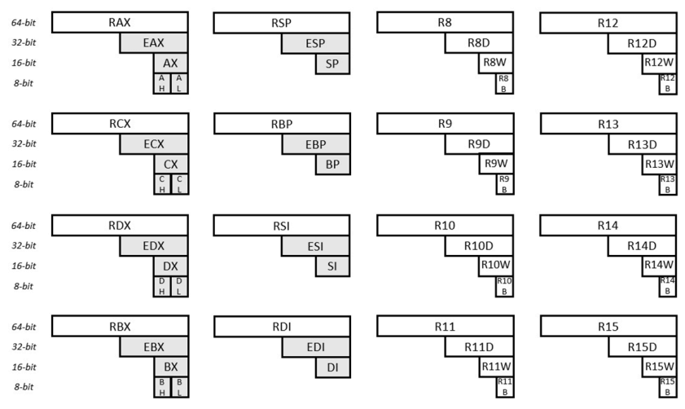
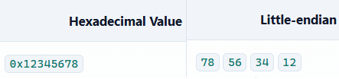
Calling a WIN32 API in X64
The parameters are RCX,RDX,R8,R9 (but you must also allocate a shadow space on the stack : of 0x28 (40) bytes : the 4x64bits params(32bytes) + 8 bytes for alignment ????
Stack must be aligned on 16bytes (ie the RSP value must be xxxx xxxx xxxx xxx0
Note that zeroing the 32bits register automatically Zeroes the full 64 bit register

Slide 11
The iData
Import Directory Table (IDT): one entry per DLL: pointer to DLL name, IAT, ILT
Import Lookup Table (ILT) aka Original First Thunk : pointers to functions
DLL Names (names in text)
Function Names : Hint followed by the name
Import Address Table (IAT): this is where the loader will write the actual addresses of the functions

Slide 12
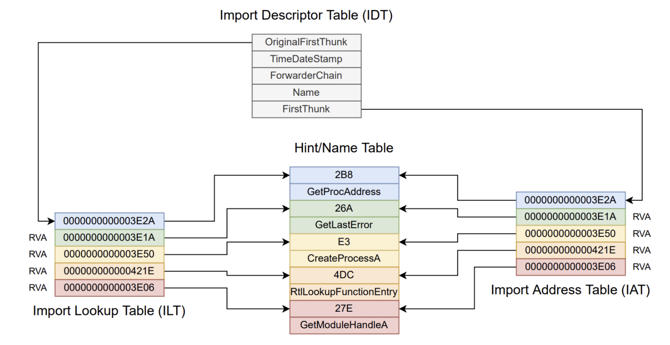
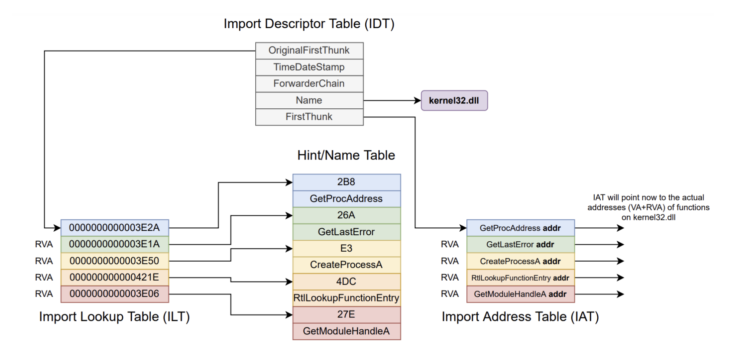

Slide 13
The code
C | Assembler | Machine code
int main() { | sub rsp, 28h | 48 83 ec 28
MessageBoxA( NULL, "haha", "titre", 0); | xor r9d, r9d lea r8, [“titre”] lea rdx, [“haha”] xor ecx,ecx call QWORD PTR MessageBoxA Nop | 45 33 c9 4c 8d 05 32 10 00 00 48 8d 15 33 10 00 00 33 c9 ff 15 e3 0f 00 00 90
return 0; } | xor eax,eax add rsp,28h ret | 33 c0 48 83 c4 28 C3
RIP(=0x100e)
+ 00001032
=0x2040
RIP(= 0x1015)
+ 00001033
=0x2048
00000fe3 (RIP =0x101D)

Slide 14
Made vby IA !!
A Win32 EXE calls a DLL through a very specific chain of events inside the Windows loader (ntdll.dll + kernel32.dll). Here is the clear, detailed, technical explanation you’re looking for — the real mechanics, not the usual superficial overview.
🧩 Concise takeaway
A Win32 EXE calls a DLL because the Windows loader maps the DLL into the process, resolves its imported functions by fixing up the IAT (Import Address Table), runs its entry point (DllMain), and then the EXE simply calls the function through the IAT like a normal function pointer
1. How the EXE declares it needs a DLL
There are two ways:
A. Static linking (most common)
The EXE contains:
Import Directory
Import Lookup Table (ILT)
Import Address Table (IAT)
These structures list:
DLL names ("user32.dll", "mydll.dll")
Function names or ordinals (MessageBoxA, MyFunction)
This is all inside the EXE’s PE header.

Slide 15
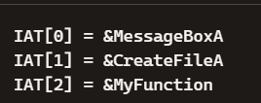
2. What happens when the EXE starts
When you double‑click the EXE:
Step 1 — Windows loader reads the PE header
It finds the Import Directory and sees which DLLs must be loaded.
Step 2 — Loader maps each DLL
For each DLL:
Finds the file on disk (search order: application dir → system32 → PATH)
Maps it into memory using CreateFileMapping + MapViewOfFile
Applies relocations if the DLL cannot be loaded at its preferred base address
Step 3 — Loader resolves imported functions
For each imported function:
Looks up the function in the DLL’s Export Table
Writes the function’s address into the EXE’s IAT
So the IAT becomes a table of real function pointers.

Slide 16
How the EXE actually calls the DLL
After the loader finishes, the EXE starts executing its own main() or WinMain().
When the EXE calls a DLL function, it is literally doing:
asm
call [IAT + offset]
The compiler generates an indirect call through the IAT entry.
So:
c
MessageBoxA(NULL, "Hello", "Title", 0);
becomes:
asm
mov eax, [IAT_MessageBoxA]
call eax
The DLL code executes inside the EXE’s process.

Slide 17
IA generated
5. Memory layout after loading
Inside the EXE’s process:
Code
[EXE .text]
[EXE .data]
[EXE IAT]
[DLL1 .text]
[DLL1 .data]
[DLL2 .text]
[DLL2 .data]
...
All DLLs share the same address space.
🛠 6. Relocations
If a DLL cannot be loaded at its preferred base address (e.g., 0x10000000), the loader:
Reads the relocation table
Applies fixups to absolute addresses inside the DLL
This ensures the DLL works at any address.
🧪 7. Exports and imports
DLL exports are stored in:
Export Directory
Function name table
Ordinal table
Address table
EXE imports reference these tables.

Slide 18
🧨 8. What happens if something fails
DLL not found → ERROR_MOD_NOT_FOUND
Function not found → ERROR_PROC_NOT_FOUND
DllMain returns FALSE → EXE fails to start
🧠 9. Why this design exists
Multiple EXEs can share the same DLL in memory
Updates to DLLs don’t require recompiling EXEs
Reduces memory footprint
Enables plugins and modular architecture

